Slide 1
ADTS, STACKS AND QUEUES

Slide 2
Data Type
Definition: “A data type defines a set of values and a set of operations that can be applied on those values.”
Most of the programming languages provide a set of basic data types also called as atomic data types or primitive data types.
Example 1: Integers: (int in C language)
values : ……-2,-1,0,1,2,…..
operations : *, +, /, - , %....
Data type has a particular representation: 1’s Complement, 2’s Complement or Sign magnitude.
However the representation is abstract to the user (user need not worry about the representation!!!).

Slide 3
Data Type
Example 2: Character: (char in C language)
values : \0,….’A’, ’B’, ’a’, ‘b’……
operations : -, +,…….
Representation may be: ASCII, Unicode, or UTF-8….
The opposite of atomic data is composite data type, which is made up of primitive types.
Example: we may define point as a data type which is made up of x, y coordinates where x and y are floating points.

Slide 4
Abstract Data Type (ADT)
An abstract data type is a data declaration packaged together with the operations that are meaningful on the data type (composite types).
In other words, we encapsulate the data and the operation on data and we hide them from the user.
ADT has
  Declaration of data (set of values on which it operates)
  Declaration of operation( set of functions)
  and hides the representation and implementation details

Slide 5
Arrays vs. Lists
Array as a Data structure: It is an ordered set which consist of fixed number of Objects. Operations which can be performed on arrays are:
  Create an array of some fixed size,
  Store elements, retrieve elements, destroy an array
  No insertion or deletion possible (fixed size)!!!!
List: Ordered set consisting of variable number of objects.

Slide 6
Arrays vs. Lists
Operations which can be performed on Lists are:
  Create a List
  Insert elements, delete elements
  destroy a List
  Size is Not fixed size!!!!
  Define an Array?
  The most often quoted saying is: a consecutive set of memory locations. It is true that arrays are almost always implemented by using consecutive memory, but not always

Slide 7
Array as Abstract Data Type
ADT Array
objects: A set of pairs <index, value> where for each value of index there is a value from the set item. Index is a finite ordered set of one or more dimensions, for example, {0, … , n-1} for one dimension, {(0,0),(0,1),….,….,(2,1),(2,2)} for two dimensions,
etc.
Functions: for all A ∈ Array, i ∈ index, x ∈ item, j, size ∈ integer
  Array Create(j, list) ::= return an array of j dimension where list is a
  j-tuple whose ith element is the size of ith dimension
  Item Retrieve(A, i) ::= if i ∈ index retrieve the element from array A indexed by i
  Array Store(A, i, x) ::= if i ∈ index store the value x at ith index in the array A
End Array

Slide 8
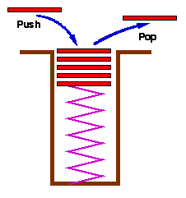
Stacks
Definition: A Stack is an ordered list in which insertions and deletions are made at one end called the top.
Insertion is called as PUSH
Deletion of an element is called as POP
Stack is also called as Last In First Out (LIFO) list.

Slide 9
A
stack: a Last-In-First-Out (LIFO) list
B
A
C
B
A
D
C
B
A
E
D
C
B
A
top
D
C
B
A
top
top
top
A
top
top
Figure 3.1: Inserting and deleting elements in a stack
CHAPTER 3

Slide 10
Stack - Relavance
Stacks appear in computer programs
  Key to call / return in functions & procedures
  Stack frame allows recursive calls
  Call: push stack frame
  Return: pop stack frame
Stack frame
  Function arguments
  Return address
  Local variables
CHAPTER 3

Slide 11
Use of Stacks in Function call – System Stack
Whenever a function is invoked program creates a structure called activation record or a stack frame and places it on top of system stack.
Initially, the activation record for the invoked functions contains only a pointer to the previous frame and return address.
The previous stack frame pointer points to the stack frame of invoking function.
CHAPTER 3

Slide 12
Use of Stacks in Function call – System Stack
While return address contains the location of the statement to be executed after the function terminates.
Only one function executes at given time which is the top of stack.
If this function invokes another, the non-static local variables parameters of invoking function are added to stack frame.
CHAPTER 3

Slide 13
Stacks in Function call – System Stack
Assume that main() invokes function a1.
It creates stack frame for a1.
Frame pointer is a pointer to the current stack frame
Also system maintains separately a stack pointer
When a function terminates, its stack frame is removed
Processing of invoking which is on top of stack continues
CHAPTER 3

Slide 14
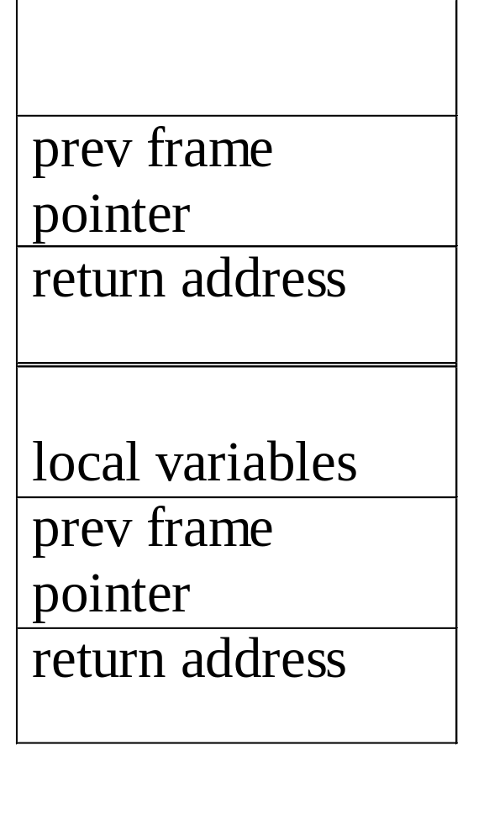
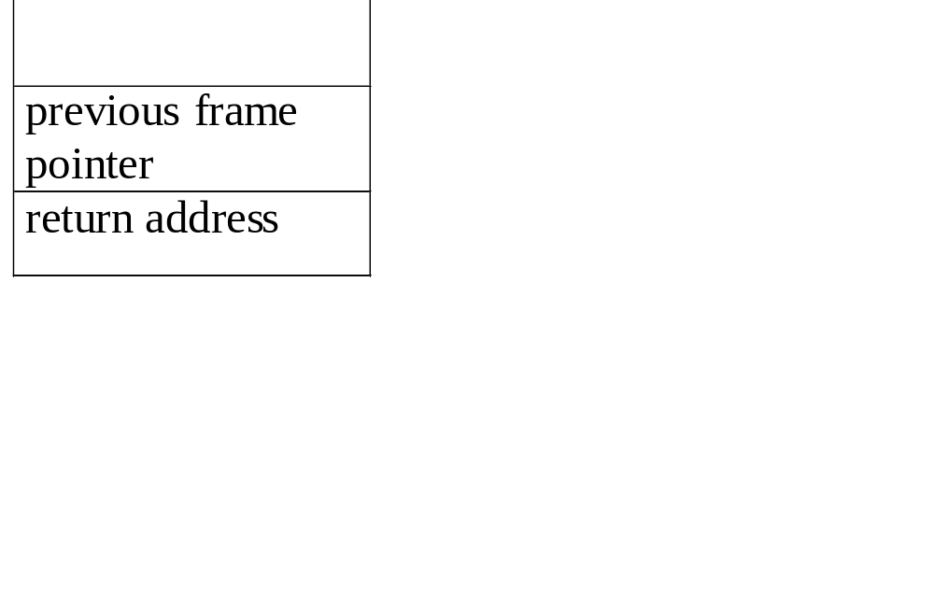
An application of stack: stack frame of function call
(activation record)
fp: a pointer to current stack frame
fp
al
fp
main
stack frame of invoking function
system stack before a1 is invoked
system stack after a1 is invoked
(a) (b)
*Figure 3.2: System stack after function call a1 (p.103)
CHAPTER 3

Slide 15
abstract data type for stack
ADT Stack is
objects: a finite ordered list with zero or more elements.
functions:
for all stack ∈ Stack, item ∈ element, max_stack_size
∈ positive integer
Stack CreateS(max_stack_size) ::=
create an empty stack whose maximum size is
max_stack_size
Boolean IsFull(stack, max_stack_size) ::=
if (number of elements in stack == max_stack_size)
return TRUE
else return FALSE
Stack Add(stack, item) ::=
if (IsFull(stack)) stack_full
else insert item into top of stack and return
CHAPTER 3

Slide 16
Boolean IsEmpty(stack) ::=
if(stack == CreateS(max_stack_size))
return TRUE
else return FALSE
Element Delete(stack) ::=
if(IsEmpty(stack)) return
else remove and return the item on the top
of the stack.
*Structure 3.1: Abstract data type Stack (p.104)
CHAPTER 3

Slide 17
Implementation: using array
Stack CreateS(max_stack_size) ::=
#define MAX_STACK_SIZE 100 /* maximum stack size */
typedef struct {
int key;
/* other fields */
} element;
element stack[MAX_STACK_SIZE];
int top = -1;
Boolean IsEmpty(Stack) ::= top< 0;
Boolean IsFull(Stack) ::= top >= MAX_STACK_SIZE-1;
CHAPTER 3

Slide 18
Add to a stack
void add(int *top, element item)
{
/* add an item to the global stack */
if (*top >= MAX_STACK_SIZE-1) {
stack_full( );
return;
}
stack[++*top] = item;
}
*program 3.1: Add to a stack
CHAPTER 3

Slide 19
element delete(int *top)
{
/* return the top element from the stack */
if (*top == -1)
return stack_empty( ); /* returns and error key */
return stack[(*top)--];
}
*Program 3.2: Delete from a stack
Delete from a stack
CHAPTER 3

Slide 20
Queues
Definition: A queue is an ordered list in which insertions and deletions takes place at different ends .
New elements are added to rear end
Old elements are deleted from front end
Since first element inserted is the first element deleted queues is also known as First-In-First-Out (FIFO ) lists.
CHAPTER 3

Slide 21
Queue: a First-In-First-Out (FIFO) list
A
B
A
C
B
A
D
C
B
A
rear
front
D
C
B
rear
front
rear
front
rear
front
rear
front
*Figure 3.4: Inserting and deleting elements in a queue (p.106)
CHAPTER 3

Slide 22
Queues - Application
Used by operating system (OS) to create job queues.
If OS does not use priorities then the jobs are processed in the order they enter the system
CHAPTER 3

Slide 23
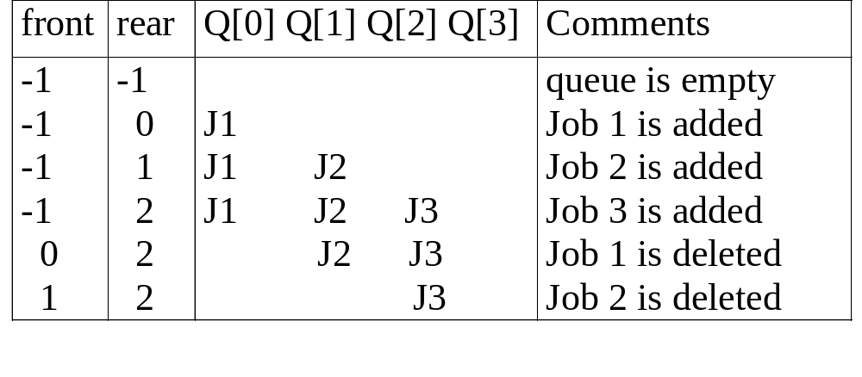
Application: Job scheduling
*Figure 3.5: Insertion and deletion from a sequential queue (p.108)
CHAPTER 3

Slide 24
Abstract data type of queue
structure Queue is
objects: a finite ordered list with zero or more elements.
functions:
for all queue ∈ Queue, item ∈ element,
max_ queue_ size ∈ positive integer
Queue CreateQ(max_queue_size) ::=
create an empty queue whose maximum size is
max_queue_size
Boolean IsFullQ(queue, max_queue_size) ::=
if(number of elements in queue == max_queue_size)
return TRUE
else return FALSE
Queue AddQ(queue, item) ::=
if (IsFullQ(queue)) queue_full
else insert item at rear of queue and return queue
CHAPTER 3

Slide 25
Boolean IsEmptyQ(queue) ::=
if (queue ==CreateQ(max_queue_size))
return TRUE
else return FALSE
Element DeleteQ(queue) ::=
if (IsEmptyQ(queue)) return
else remove and return the item at front of queue.
*Structure 3.2: Abstract data type Queue (p.107)
CHAPTER 3

Slide 26
Implementation 1: using array
Queue CreateQ(max_queue_size) ::=
# define MAX_QUEUE_SIZE 100/* Maximum queue size */
typedef struct {
int key;
/* other fields */
} element;
element queue[MAX_QUEUE_SIZE];
int rear = -1;
int front = -1;
Boolean IsEmpty(queue) ::= front == rear
Boolean IsFullQ(queue) ::= rear == MAX_QUEUE_SIZE-1
CHAPTER 3

Slide 27
Add to a queue
void addq(int *rear, element item)
{
/* add an item to the queue */
if (*rear == MAX_QUEUE_SIZE_1) {
queue_full( );
return;
}
queue [++*rear] = item;
if front==-1
front=0;
}
*Program 3.3: Add to a queue
CHAPTER 3

Slide 28
Delete from a queue
element deleteq(int *front, int *rear)
{
/* remove element at the front of the queue */
if ( *front == -1)
return queue_empty( );
temp=*front ;
if ( *front == *rear)
*front = *rear=-1;
else
++ *front
return queue [temp];
}
*Program 3.4: Delete from a queue
problem: there may be available space when IsFullQ is true
I.E. movement is required.
CHAPTER 3

Slide 29
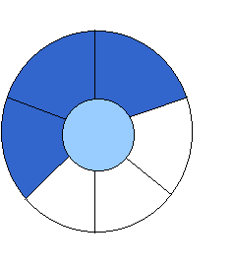
Implementation 2: regard an array as a circular queue
front: one position counterclockwise from the first element
rear: current end
EMPTY QUEUE
[2]
[3] [2] [3]
J2
J3
[1] [4] [1] [4]
J1
[0] [5] [0] [5]
front = 0 front = 0
rear = 0 rear = 3
*Figure 3.6: Empty and nonempty circular queues (p.109)
CHAPTER 3

Slide 30

Problem: one space is left when queue is full
FULL QUEUE FULL QUEUE
[2] [3] [2] [3]
J2 J3
J8 J9
J7
[1] [4][1] [4]
J1 J4
J5
J6 J5
[0] [5] [0] [5]
front =0
rear = 5
front =4
rear =3
*Figure 3.7: Full circular queues and then we remove the item (p.110)
CHAPTER 3

Slide 31
void addq(int front, int *rear, element item)
{
/* add an item to the queue */
*rear = (*rear +1) % MAX_QUEUE_SIZE;
if (front == *rear) /* reset rear and print error */
return;
}
queue[*rear] = item;
if front==-1
front=0;
}
*Program 3.5: Add to a circular queue (p.110)
Add to a circular queue
CHAPTER 3

Slide 32
element deleteq(int* front, int rear)
{
element item;
/* remove front element from the queue and put it in item */
if (*front == rear)
return queue_empty( );
/* queue_empty returns an error key */
*front = (*front+1) % MAX_QUEUE_SIZE;
return queue[*front];
}
*Program 3.6: Delete from a circular queue (p.111)
Delete from a circular queue
CHAPTER 3

Slide 33
Infix prefix and postfix expression
In an expression if the binary operator, which performs an operation , is written in between the operands it is called an infix expression. Ex: a+b*c
If the operator is written before the operands , it is called prefix expression
Ex: +a*bc
If the operator is written after the operands, it is called postfix expression.
Ex: abc* +
CHAPTER 3

Slide 34
Infix, prefix, and Postfix expression
An expression in infix form is dependent of precedence during evaluation
Ex: to evaluate a+b*c, sub expression a+b can be evaluated only after evaluating b*c.
As soon as we get an operator we cannot perform the operation specified the operator
So it takes more time for compilers to check precedence to evaluate sub expression.
CHAPTER 3

Slide 35
Infix, prefix, and Postfix expression
Both prefix and postfix representations are independent of precedence of operators.
In a single scan an entire expression can be evaluated
Takes less time to evaluate. However infix expressions have to be converted to postfix or prefix.
CHAPTER 3

Slide 36
Evaluation of Expressions
X = a / b - c + d * e - a * c
a = 4, b = c = 2, d = e = 3
Interpretation 1:
((4/2)-2)+(3*3)-(4*2)=0 + 8+9=1
Interpretation 2:
(4/(2-2+3))*(3-4)*2=(4/3)*(-1)*2=-2.66666…
How to generate the machine instructions corresponding to a given expression?
precedence rule + associative rule
CHAPTER 3

Slide 37
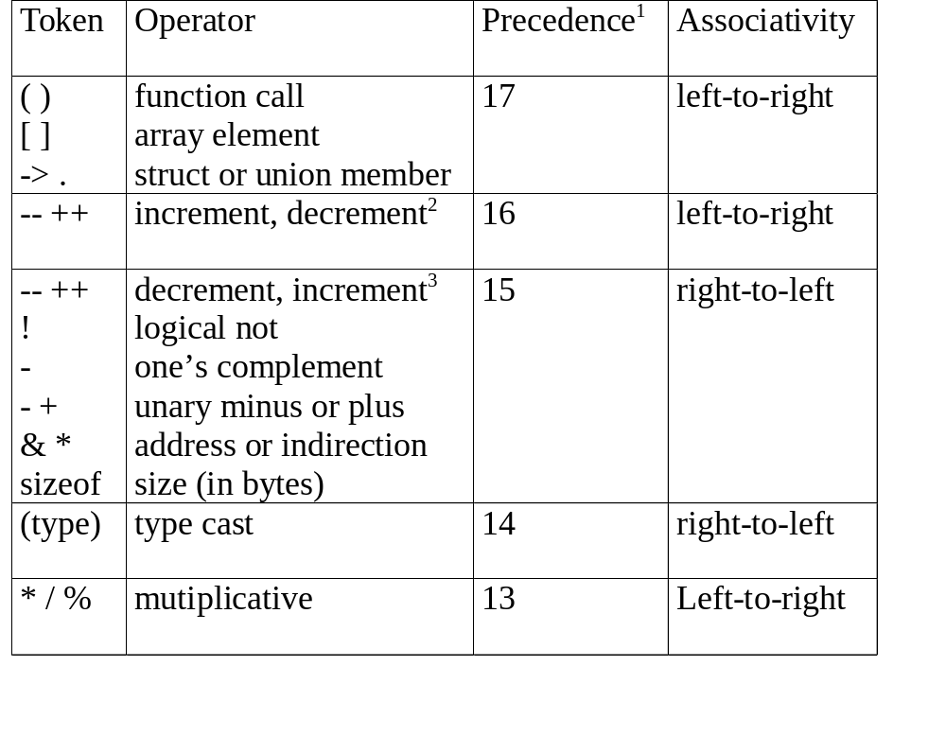
CHAPTER 3

Slide 38
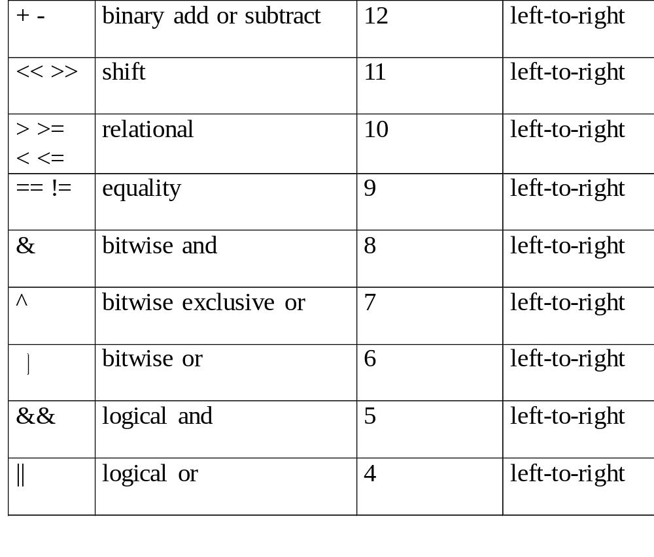
CHAPTER 3

Slide 39
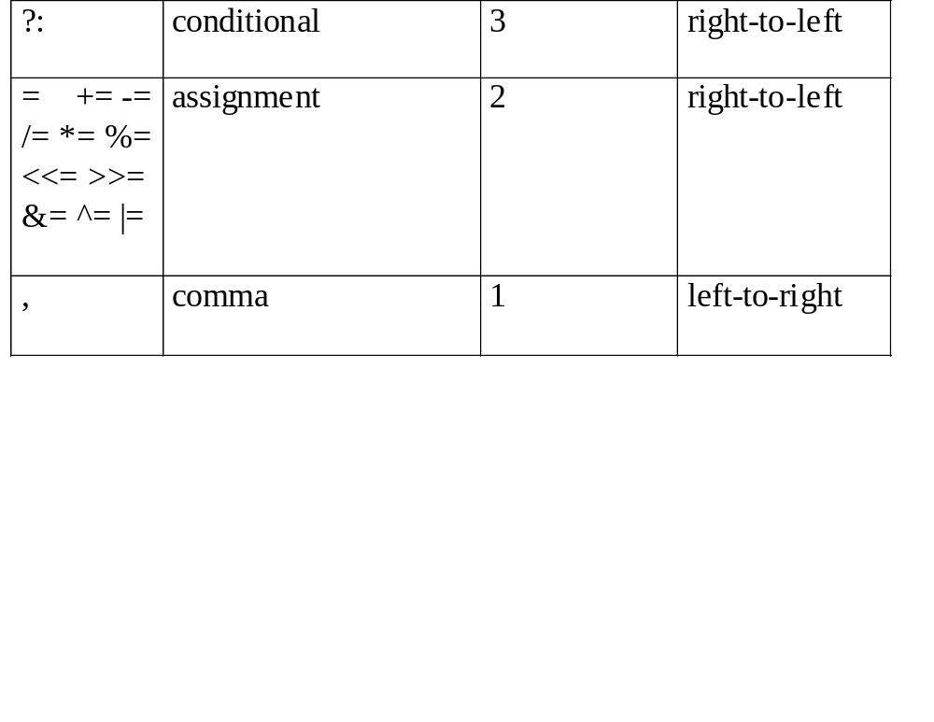
1.The precedence column is taken from Harbison and Steele.
2.Postfix form
3.prefix form
*Figure 3.12: Precedence hierarchy for C
CHAPTER 3

Slide 40
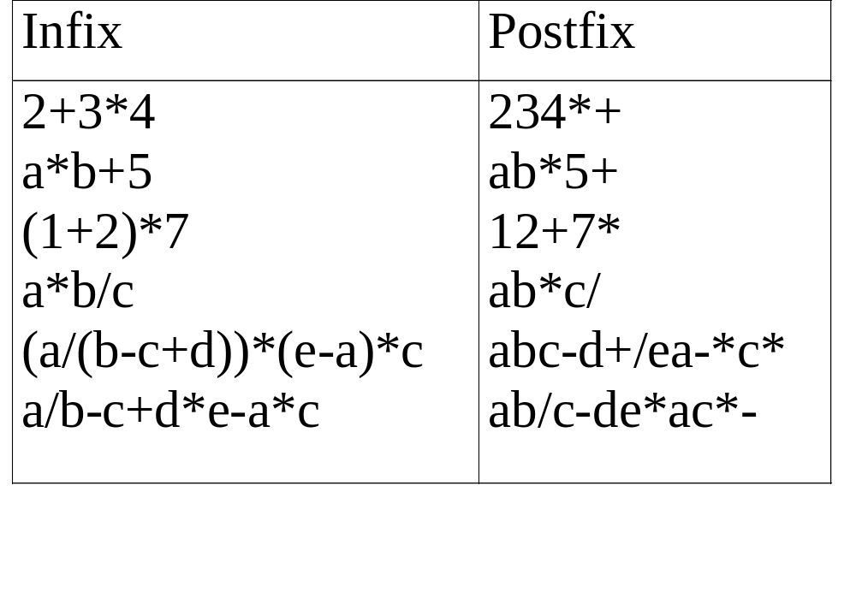
user
compiler
*Figure 3.13: Infix and postfix notation .
Postfix: no parentheses, no precedence
CHAPTER 3

Slide 41
Infix to Postfix Conversion
(Intuitive Algorithm/ Manual method)
(1) Fully parenthesize expression
a / b - c + d * e - a * c -->
((((a / b) - c) + (d * e)) - a * c))
(2) All operators replace their corresponding right
parentheses.
((((a / b) - c) + (d * e)) - a * c))
(3) Delete all parentheses.
ab/c-de*+ac*-
two passes
/
-
*
*
+
-
CHAPTER 3

Slide 42
Infix to postfix conversion: Sample Exercises
Convert the following infix expression to postfix expression
a+b*c+d*e
a*b+5
((a/(b-c+d))*(e-a)*c
a/b-c+d*e-a*c
CHAPTER 3

Slide 43
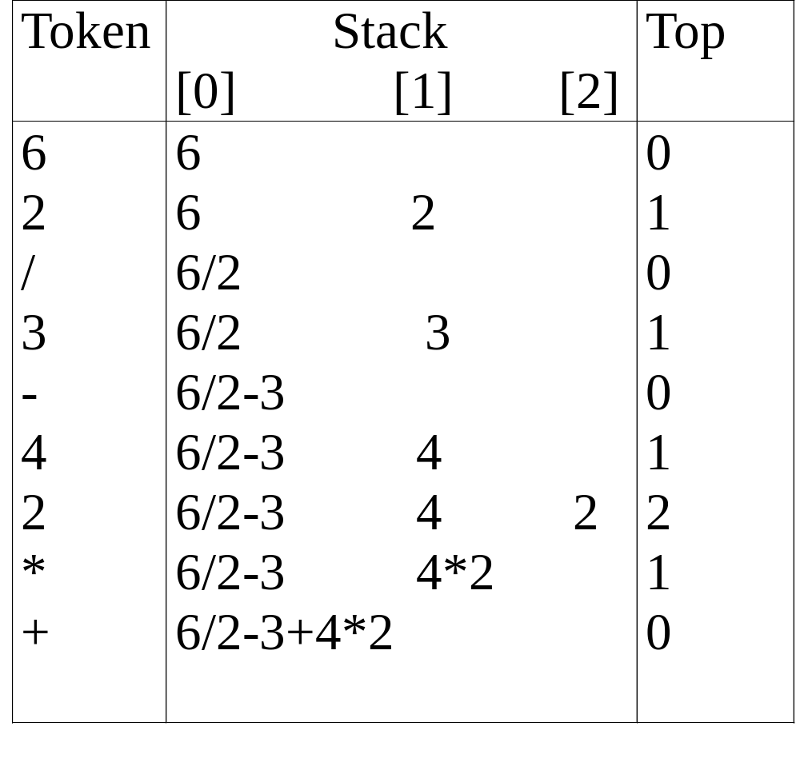
Evaluation of Postfix Using Stack
*Figure 3.14: Postfix evaluation (p.120)
CHAPTER 3

Slide 44
Evaluate postfix expression
Assumptions:
operators: +, -, *, /, %
operands: single digit integer
#define MAX_STACK_SIZE 100 /* maximum stack size */
#define MAX_EXPR_SIZE 100 /* max size of expression */
typedef enum{lparan, rparen, plus, minus, times, divide,
mod, eos, operand} precedence;
int stack[MAX_STACK_SIZE]; /* global stack */
char expr[MAX_EXPR_SIZE]; /* input string */
CHAPTER 3

Slide 45
int eval(void)
{
/* evaluate a postfix expression, expr, maintained as a
global variable, ‘\0’ is the the end of the expression.
The stack and top of the stack are global variables.
get_token is used to return the token type and
the character symbol. Operands are assumed to be single
character digits */
precedence token;
char symbol;
int op1, op2;
int n = 0; /* counter for the expression string */
int top = -1;
token = get_token(&symbol, &n);
while (token != eos) {
if (token == operand)
add(&top, symbol-’0’); /* stack insert */
exp: character array
CHAPTER 3

Slide 46
else {
/* remove two operands, perform operation, and
return result to the stack */
op2 = delete(&top); /* stack delete */
op1 = delete(&top);
switch(token) {
case plus: add(&top, op1+op2); break;
case minus: add(&top, op1-op2); break;
case times: add(&top, op1*op2); break;
case divide: add(&top, op1/op2); break;
case mod: add(&top, op1%op2);
}
}
token = get_token (&symbol, &n);
}
return delete(&top); /* return result */
}
*Program 3.9: Function to evaluate a postfix expression (p.122)

Slide 47
precedence get_token(char *symbol, int *n)
{
/* get the next token, symbol is the character
representation, which is returned, the token is
represented by its enumerated value, which
is returned in the function name */
*symbol =expr[(*n)++];
switch (*symbol) {
case ‘(‘ : return lparen;
case ’)’ : return rparen;
case ‘+’: return plus;
case ‘-’ : return minus;
CHAPTER 3

Slide 48
case ‘/’ : return divide;
case ‘*’ : return times;
case ‘%’ : return mod;
case ‘\0‘ : return eos;
default : return operand;
/* no error checking, default is operand */
}
}
*Program 3.10: Function to get a token from the input string (p.123)
CHAPTER 3

Slide 49
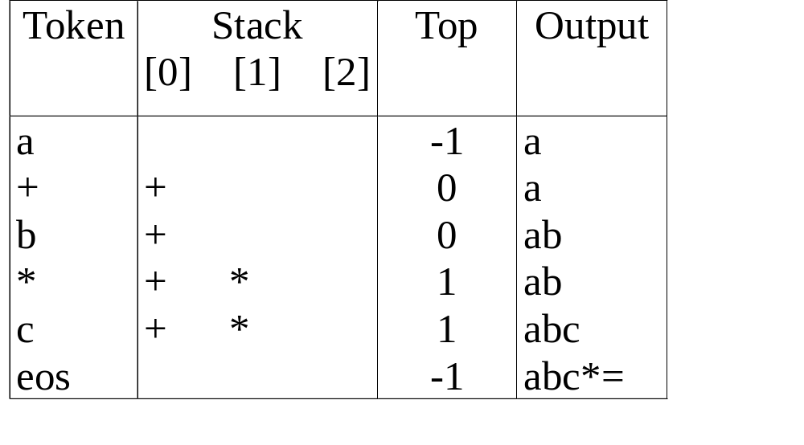
Infix to Postfix Conversion (Using Stack)
*Figure 3.15: Translation of a+b*c to postfix (p.124)
The orders of operands in infix and postfix are the same.
a + b * c, * > +
CHAPTER 3

Slide 50
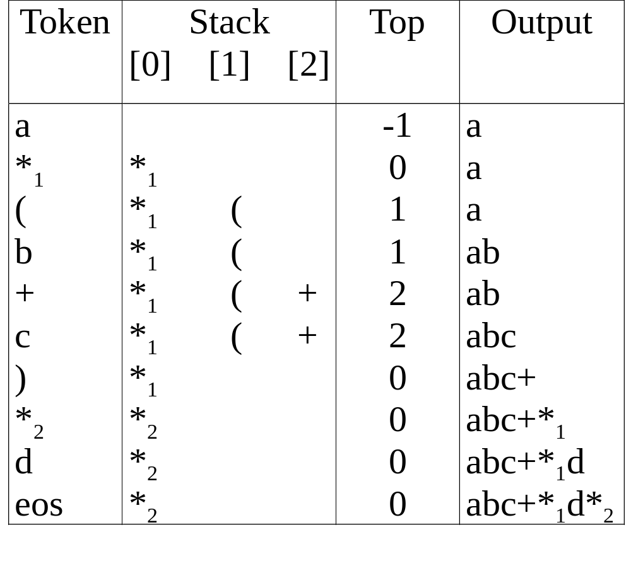
a *₁ (b +c) *₂ d
match )
*₁ = *₂
* Figure 3.16: Translation of a*(b+c)*d to postfix (p.124)

Slide 51
Rules
(1) Operators are taken out of the stack as long as their
in-stack precedence is higher than or equal to the
incoming precedence of the new operator.
(2) ( has low in-stack precedence, and high incoming
precedence.
( ) + - * / % eos
isp 0 19 12 12 13 13 13 0
icp 20 19 12 12 13 13 13 0
CHAPTER 3

Slide 52
precedence stack[MAX_STACK_SIZE];
/* isp and icp arrays -- index is value of precedence
lparen, rparen, plus, minus, times, divide, mod, eos */
static int isp [ ] = {0, 19, 12, 12, 13, 13, 13, 0};
static int icp [ ] = {20, 19, 12, 12, 13, 13, 13, 0};
isp: in-stack precedence
icp: incoming precedence
CHAPTER 3

Slide 53
void postfix(void)
{
/* output the postfix of the expression. The expression
string, the stack, and top are global */
char symbol;
precedence token;
int n = 0;
int top = 0; /* place eos on stack */
stack[0] = eos;
for (token = get _token(&symbol, &n); token != eos;
token = get_token(&symbol, &n)) {
if (token == operand)
printf (“%c”, symbol);
else if (token == rparen ){
CHAPTER 3

Slide 54
/*unstack tokens until left parenthesis */
while (stack[top] != lparen)
print_token(delete(&top));
delete(&top); /*discard the left parenthesis */
}
else{
/* remove and print symbols whose isp is greater
than or equal to the current token’s icp */
while(isp[stack[top]] >= icp[token] )
print_token(delete(&top));
add(&top, token);
}
}
while ((token = delete(&top)) != eos)
print_token(token);
print(“\n”);
}
*Program 3.11: Function to convert from infix to postfix (p.126)
CHAPTER 3

Slide 55
Infix to postfix conversion using stack
Convert the following infix expression to postfix expression using a stack . Show the instances of stack during conversion.
a+b*c+d*e
a*b+5
((a/(b-c+d))*(e-a)*c
a/b-c+d*e-a*c
CHAPTER 3

Slide 56
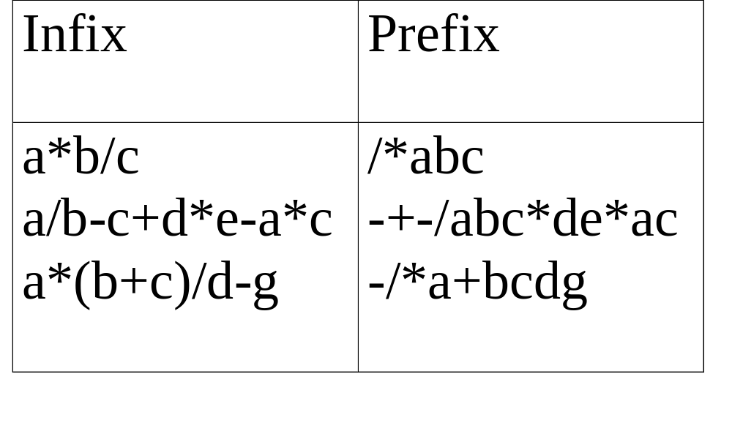
(1) evaluation
(2) transformation
*Figure 3.17: Infix and postfix expressions (p.127)
CHAPTER 3

Slide 57
Multiple stacks and queues
Two stacks
m[0], m[1], …, m[n-2], m[n-1]
bottommost bottommost
stack 1 stack 2
More than two stacks (n)
memory is divided into n equal segments
boundary[stack_no]
0 ≤ stack_no < MAX_STACKS
top[stack_no]
0 ≤ stack_no < MAX_STACKS
CHAPTER 3

Slide 58
Initially, boundary[i]=top[i].
0 1 [ m/n ] 2[ m/n ] m-1
boundary[ 0] boundary[1] boundary[ 2] boundary[n]
top[ 0] top[ 1] top[ 2]
All stacks are empty and divided into roughly equal segments.
*Figure 3.18: Initial configuration for n stacks in memory [m]. (p.129)
CHAPTER 3

Slide 59
#define MEMORY_SIZE 20/* size of memory */
#define MAX_STACK_SIZE 2
/* max number of stacks plus 1 */
/* global memory declaration */
element memory[MEMORY_SIZE];
int top[MAX_STACKS];
int boundary[MAX_STACKS];
int n; /* number of stacks entered by the user */
top[0] = boundary[0] = -1;
for (i = 1; i < n; i++)
top[i] =boundary[i] =(MEMORY_SIZE/n)*i;
boundary[n] = MEMORY_SIZE-1;
CHAPTER 3

Slide 60
void push(int i, element item)
{
/* add an item to the ith stack */
if (top[i] == boundary [i+1])
stack_full(i); may have unused storage
memory[++top[i]] = item;
}
*Program 3.12:Add an item to the stack stack-no (p.129)
element pop(int i)
{
/* remove top element from the ith stack */
if (top[i] == boundary[i])
return stack_empty(i);
return memory[top[i]--];
}
*Program 3.13:Delete an item from the stack stack-no
CHAPTER 3

Slide 61
Find j, stack_no < j < n
such that top[j] < boundary[j+1]
or, 0 ≤ j < stack_no
b[0] t[0] b[1] t[1] b[i] t[i] t[i+1] t[j] b[j+1] b[n]
b[i+1] b[i+2]
b=boundary, t=top
*Figure 3.19: Configuration when stack i meets stack i+1,
but the memory is not full (p.130)
meet
CHAPTER 3

